Slide 1
Rockbuster Stealth LLC Analysis
File created on: 3/9/2023 1:22:06 AM

Slide 2
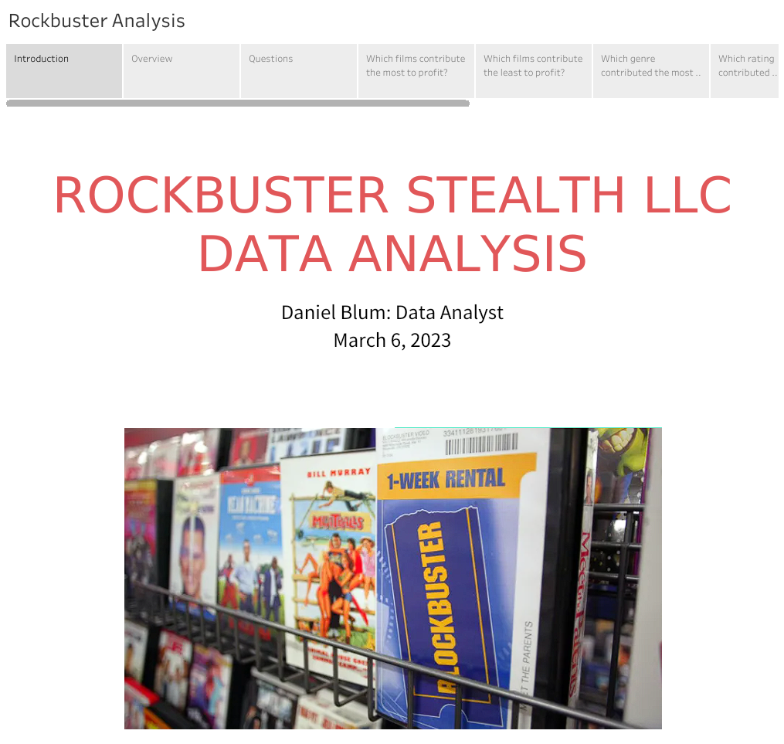

Slide 3
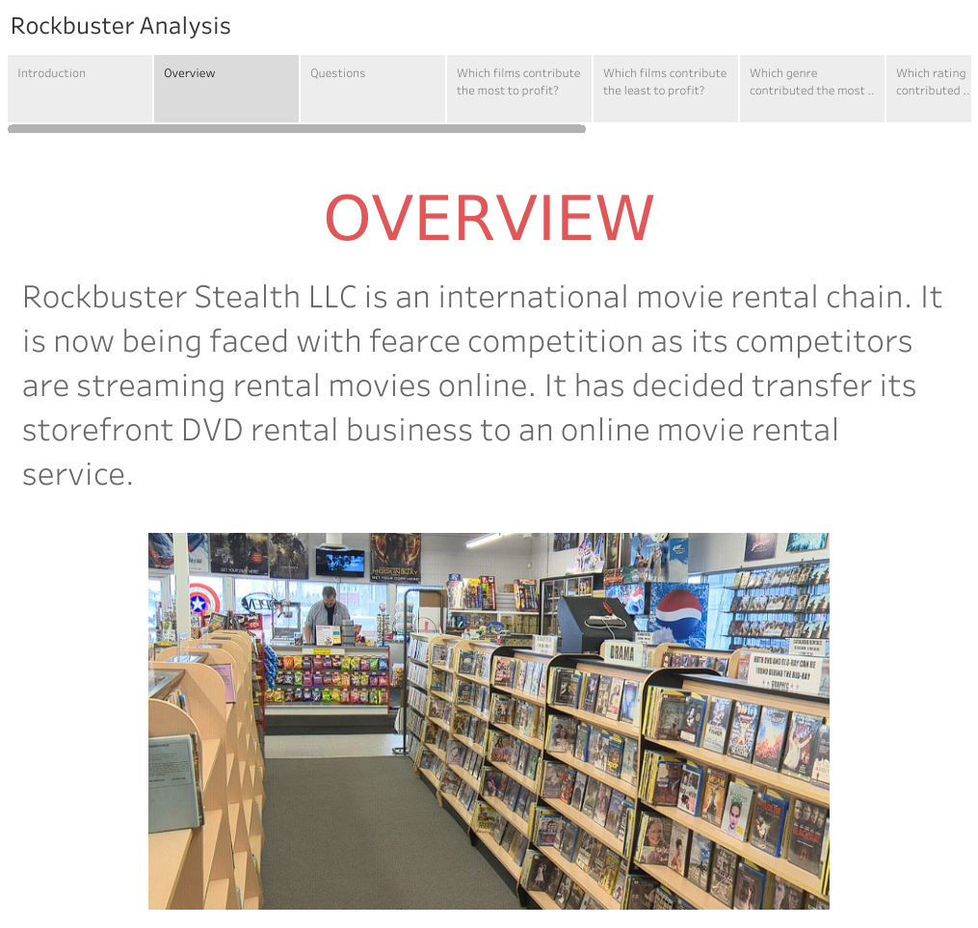

Slide 4
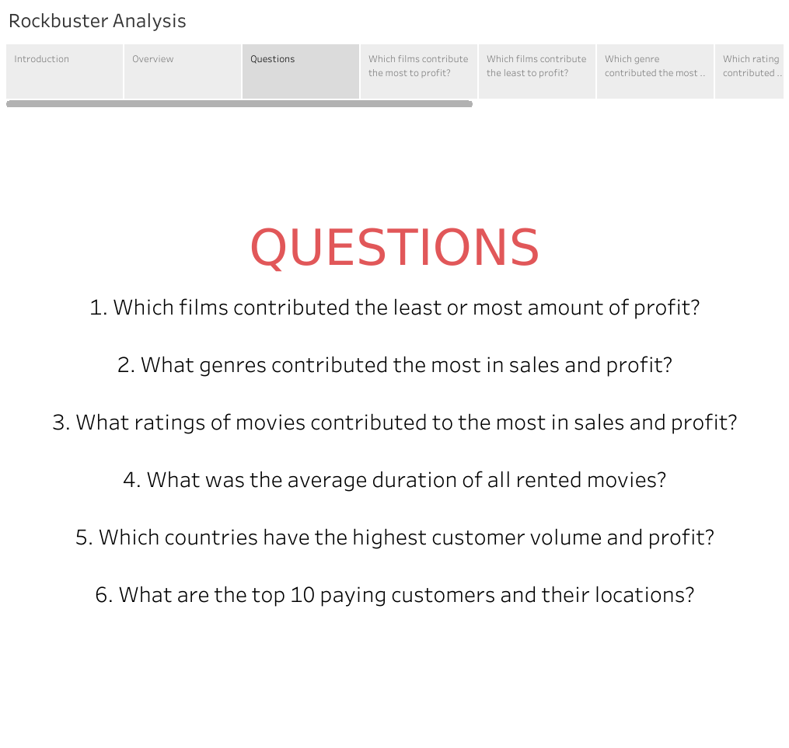

Slide 5
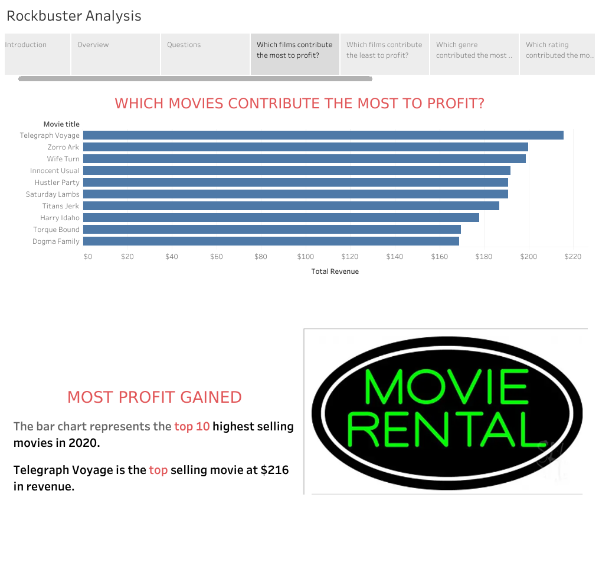

Slide 6
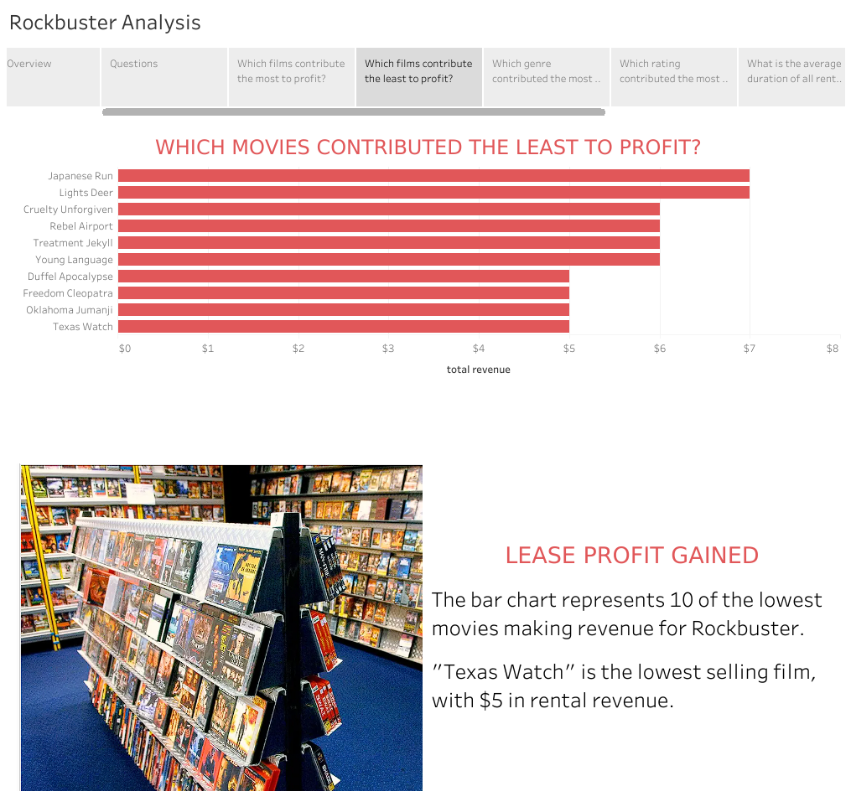

Slide 7
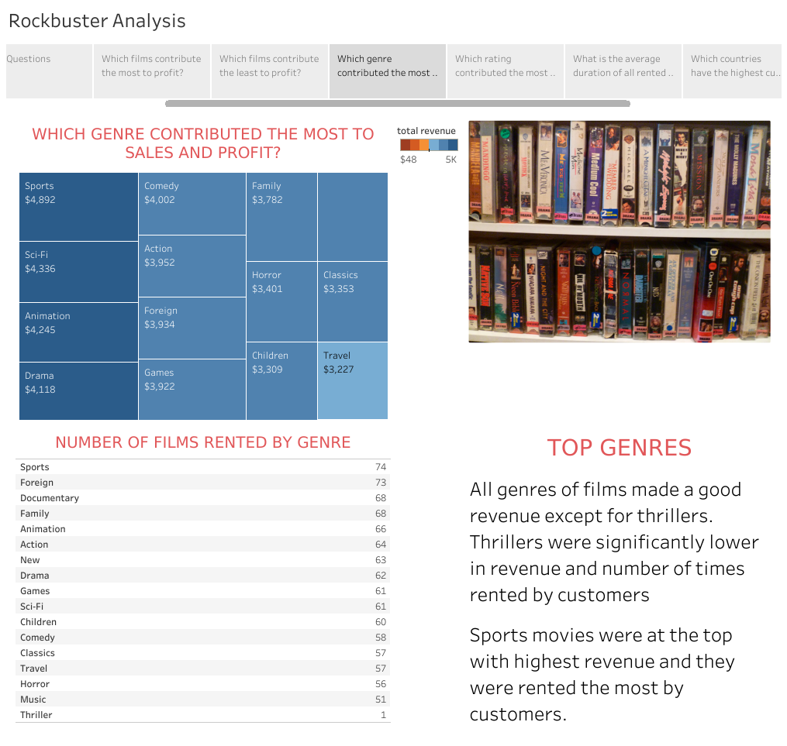

Slide 8
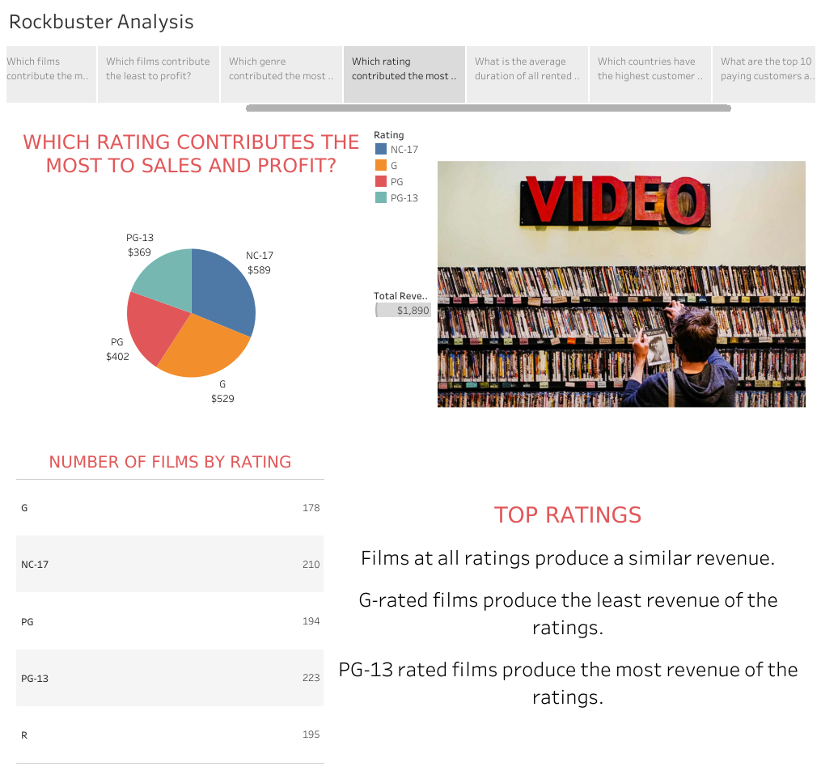

Slide 9
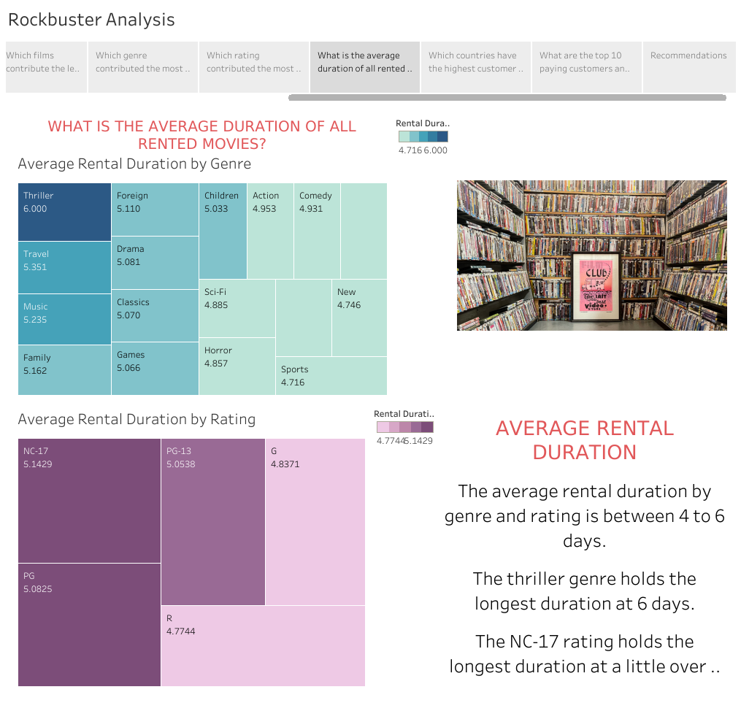

Slide 10
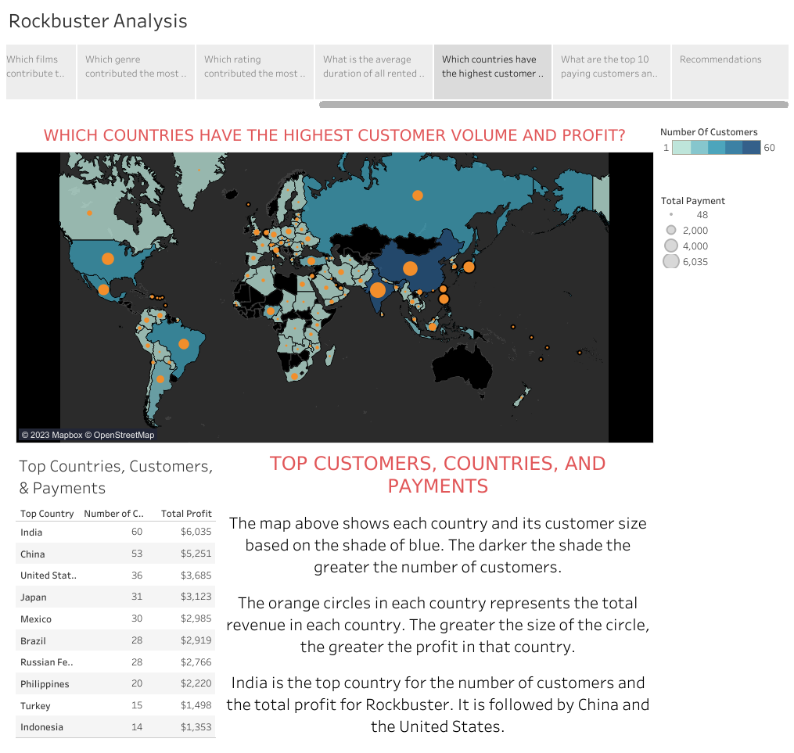

Slide 11
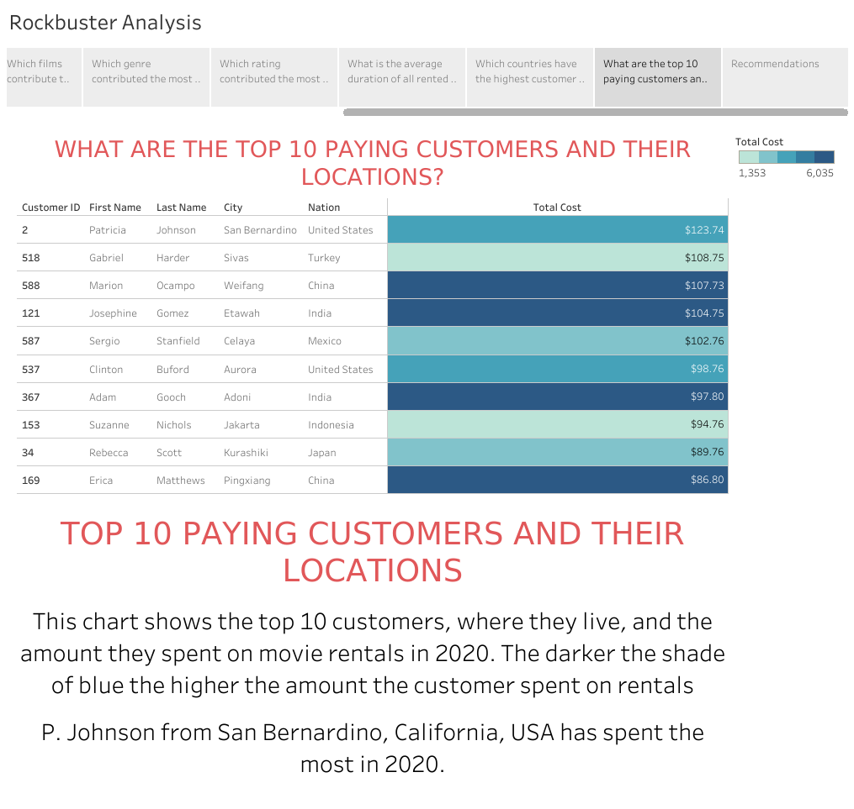

Slide 12
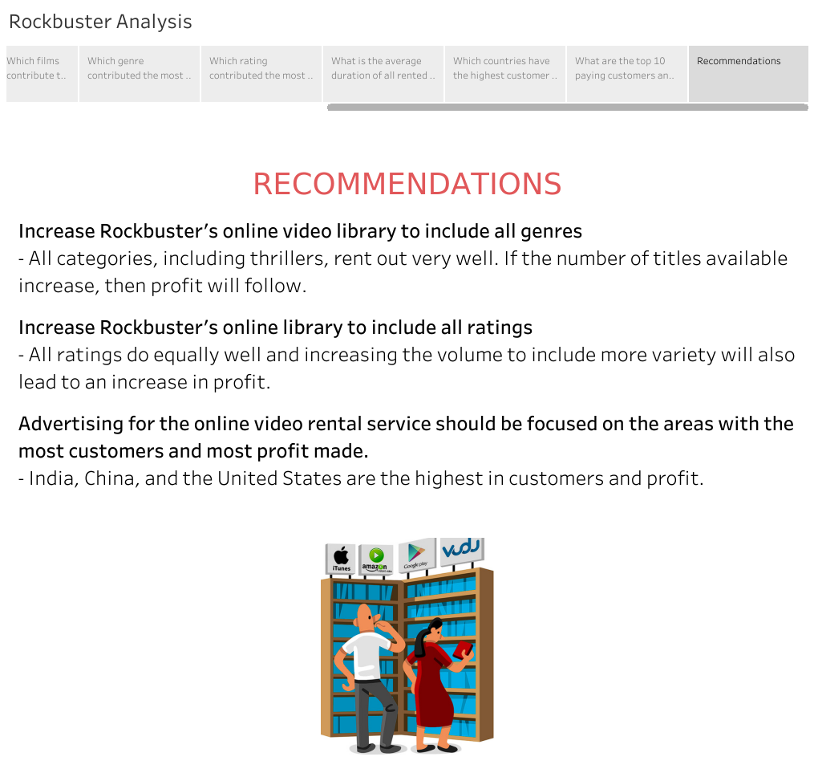

Slide 13
Tableau Link
https://public.tableau.com/app/profile/daniel.blum4497/viz/RockbusterStealthLLCAnalysis/Rockbuster?publish=yes

